Slide 1
SRCSet attributes
CIT230

Slide 2

What is SRCset
The srcset attribute allows us to provide a set of image that can be potentially served by the browser.

Slide 3

Why srcset is important?
The srcset attribute has made responsive image sizing much simpler.
Images are important to the user experience on website.
To get rid from slow loading problems in users devices.

Slide 4

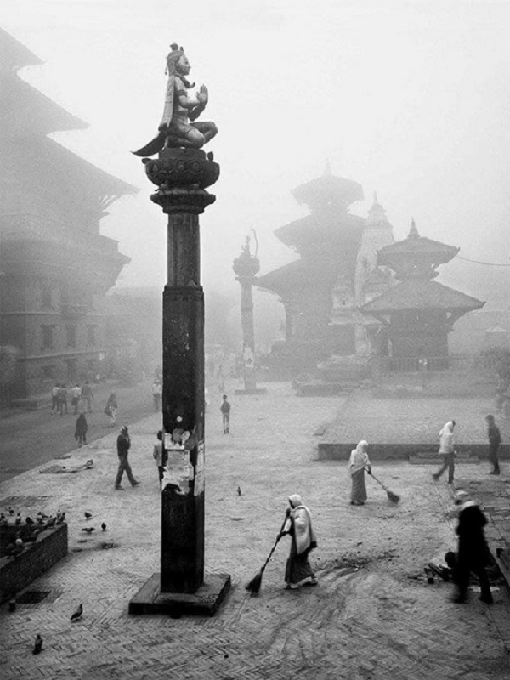

example
<html>
<head>
<title>presentation on srcset </title>
</head>
<body>
<picture>
<source srcset="images/pic3.jpg" media="(max-width:700px)">
<source srcset="images/pic2.png" media="(max-width:1024px)">
<source srcset="images/pic1.jpg">
<img src="images/picture-large.jpeg" alt="Landscaping picture">
</picture>
</body>
</html>

Slide 5
Pros and cons of srcset
Pros
You’re letting browser do the math. Picking the right image for the right screen size.
You are saving bandwidth, this means lower hosting costs for you, and lower data costs for mobile users.
Partial browser support. In fact, this is the second-best-supported option on the list.
Cons
It is only partial browser support. To make it work in older browsers including some mobile browsers. You will need to use a bit of JavaScript.

Slide 6
references
https://bitsofco.de/the-srcset-and-sizes-attributes
https://caniuse.com/#search=srcset

